Slide 1
Clustering Documents into Workspaces on Google Drive
Short Story Assignment
Presenter
Sanjana Kothari

Slide 2
The problem
With a lot of personal and work-related documents being hosted on the cloud, the aim is to automatically cluster documents into a set of working files called Workspaces. By providing workspace suggestions to users, the users can find documents pertinent to a task more efficiently and avoid having to manually group documents.
Features of documents in the cluster:
Documents are topically related
Documents are coherent and useful, i.e. useful to the user in the ongoing task

Slide 3
Limitations of the existing work
Limitation 1
Limitation 2
Limitation 3
The unsupervised methods may not be suitable as the desired clustering for Workspaces may not depend solely on document topics.
Since Workspaces is a new feature in Google Drive, the clustering labels for documents are lacking. Hence, existing supervised and semi-supervised techniques are not quite suitable.
The existing techniques focus majorly on document text for creating text representations. This makes them unsuitable due to private document corpora on Google Drive.

Slide 4
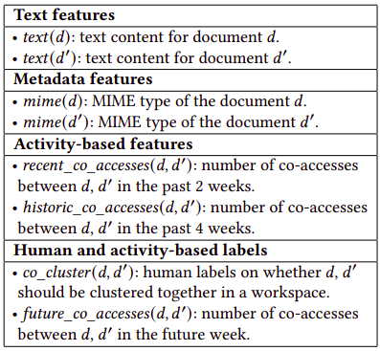
Solution
Supervised clustering and semi-supervised clustering using activity logs.
The clustering problem is modeled as a label prediction model, i.e. predicting co_cluster label denoting whether documents d and d’ are in the same cluster.

Slide 5
Implementation

Slide 6
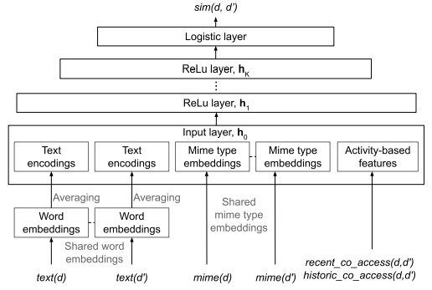



Document Similarity Model
text(d) is encoded by averaging word embeddings
Hidden layer
Output of the last layer

Slide 7
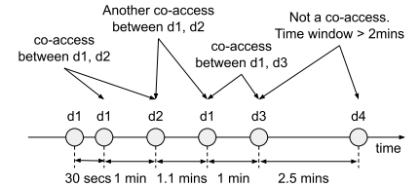
Activity-based features
Hypothesis - co_access labels indicate that two documents are likely to be related, based on the assumption that they may belong to the same task.
recent_co_accesses(𝑑, 𝑑′ ): number of co-accesses between 𝑑, 𝑑 ′ in the past 2 weeks.
historic_co_accesses(𝑑, 𝑑′ ): number of co-accesses between 𝑑, 𝑑 ′ in the past 4 weeks.
future_co_accesses(𝑑, 𝑑′ ): number of co-accesses between 𝑑, 𝑑 ′ in the future week.

Slide 8
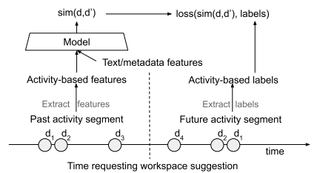
Weak-supervised clustering
Since collecting co_cluster labels is not feasible, a weakly supervised approach to document similarity is developed where future co_accesses are derived from the future activity segment.

Slide 9
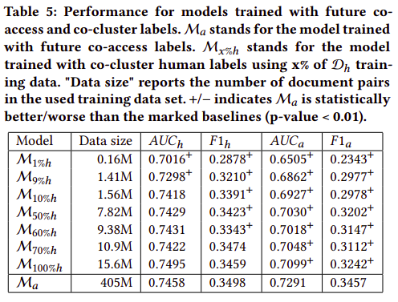
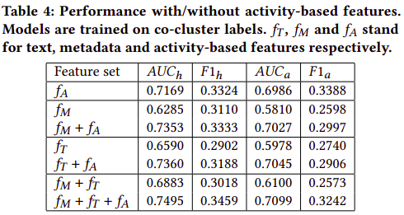
Results

Slide 10
Conclusion
CEO
First, the hypothesis is stated that document co_access can be used to measure document similarity. Then, a supervised document similarity neural model is developed which incorporates co_access features with text and metadata features. Lastly, a weakly-supervised method is proposed that uses future co_access labels which can be extracted efficiently from large scale activity logs.
Online experiment results show that the weakly-supervised method leads to better Workspace suggestions that the users accept 30%-49% more often than the suggestions made by other unsupervised approaches.

